Slide 1
NE 763: Advanced Reactor Materials
Fall 2026
Dr. Benjamin Beeler

Slide 2
Last Time
TRISO fuel performance
key focus on predicting stress state in different layers, especially SiC
utilize benchmark tests for cross-code comparisons
data needs for various material thermodynamics and kinetic properties
Material performance in He
level of impurities impacts corrosion on graphite and IHX
three graphite oxidation modes, based on temperature
for IHX, competition between decarburization and carburization dependent upon carbon activity and oxygen partial pressure
TRISO fabrication
sol-gel of kernels, CVD of outer layers, graphite matrix powder, sintering

Slide 3
Advanced concepts in TRISO

Slide 4
ZrC replacing SiC
Zirconium carbide (ZrC) is a refractory and chemically stable compound, which melts eutectically with carbon at 3123 K
ZrC can potentially improve the high-temperature stability, the resistance to chemical attack by fission products, and the retention of fission products
However, ZrC is significantly less oxidation resistant than SiC

Slide 5
ZrC replacing SiC
Four types of ZrC inclusions have been studied (1) ZrC-TRISO coated particles, (2) ZrC-TRISO type coated particles without OPyC layer, (3) ZrC-coated particles with ZrC-doped OPyC layer, and (4) ZrC coated particles with graded C–ZrC layer(s)
All four types have been fabricated and irradiated
Primary focus has been on option 1, however usage of ZrC started from option 2 in the 1970s
ZrC-TRISO-coated UO2 particle after irradiation at 1673–1923K to 4.5% FIMA

Slide 6
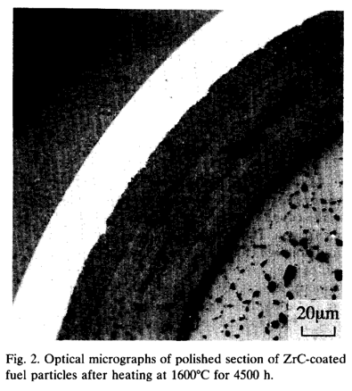
SiC vs ZrC Corrosion
An approach to counteract SiC fission product corrosion is to replace the SiC coating by a ZrC layer
Experimental observations showed neither Pd attack nor thermal degradation of ZrC up to 1600C
ZrC was also shown to have a high capacity to retain Cs, but poor retention of Ru
At higher T, the deterioration of the ZrC particle is caused by failure of the IPyC
The development of TRISO with ZrC-coating is at an early stage compared to the SiC-coated design

Slide 7
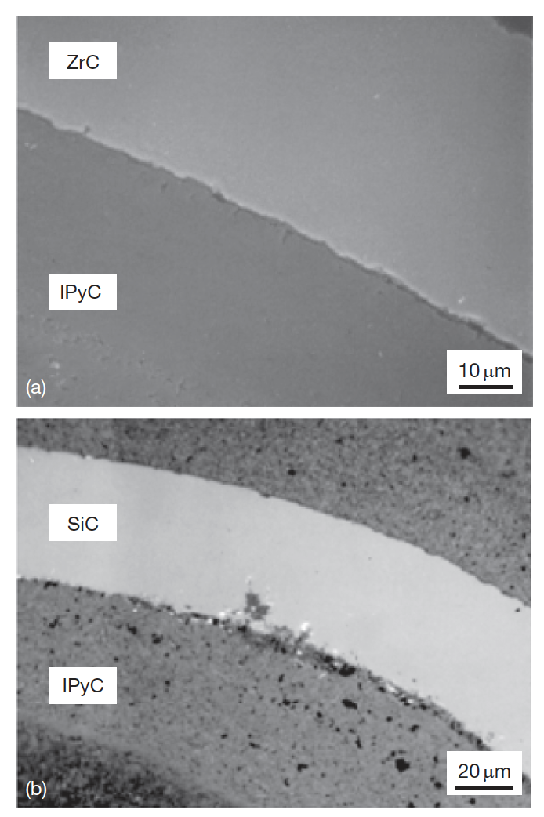
ZrC replacing SiC
The improved performance of the ZrC coating layer against chemical attack by Pd has been demonstrated in both out-of-reactor experiments and irradiation tests
ZrPd3 can form in lab conditions, but insufficient Pd exists in fuel particles to cause formation and thus degradation
ZrC does not seem to solve the silver problem
Ruthenium release might be an issue, which it is not for SiC

Slide 8
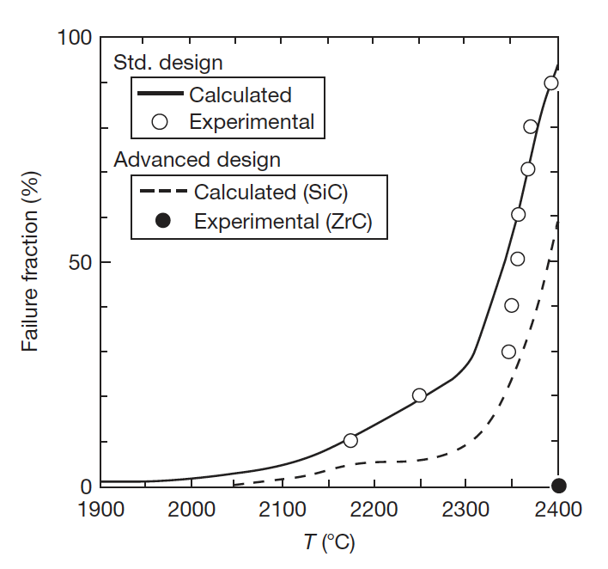
ZrC replacing SiC
High-temperature behavior of ZrC is superior to SiC
Right is a heating experiment on irradiated TRISO particles
No ZrC failures up to 2400C, where an extended hold produced a failure
At temperatures above 2000C, SiC will decompose into its constituents
Thus, better stability during fabrication, ability to operate at higher temperatures, better stability in off-normal temperature spikes, better fission gas retention at high temperature

Slide 9
Non-fissile Carbides in Fuel
To inhibit the buildup of CO gas in UO2 fuel kernels, UC2 is often added to getter oxygen and reduce the oxygen potential
Similar results can be achieved by the addition of nonfissionable carbides, such as SiC or ZrC around fuel kernel
Added as a layer around UO2 fuel kernels and/or dispersed within the buffer
As-fabricated
Irradiated

Slide 10
Non-fissile Carbides in Fuel
Introduction of ZrC around fuel kernel getters released oxygen
This seems to inhibit fuel kernel migration
If the layered ZrC is intact, can inhibit fuel swelling as well, potentially reduced stresses on outer layers
Have performed limited irradiation experiments with no failures
If the layered ZrC is intact, no release occurs for Ag and Eu
Release occurs for both species under same conditions for nominal TRISO and for ZrC dispersed in buffer
An intact ZrC layer seems to be necessary for explaining the outstanding retention of these particles, in addition to the benefits of O gettering

Slide 11
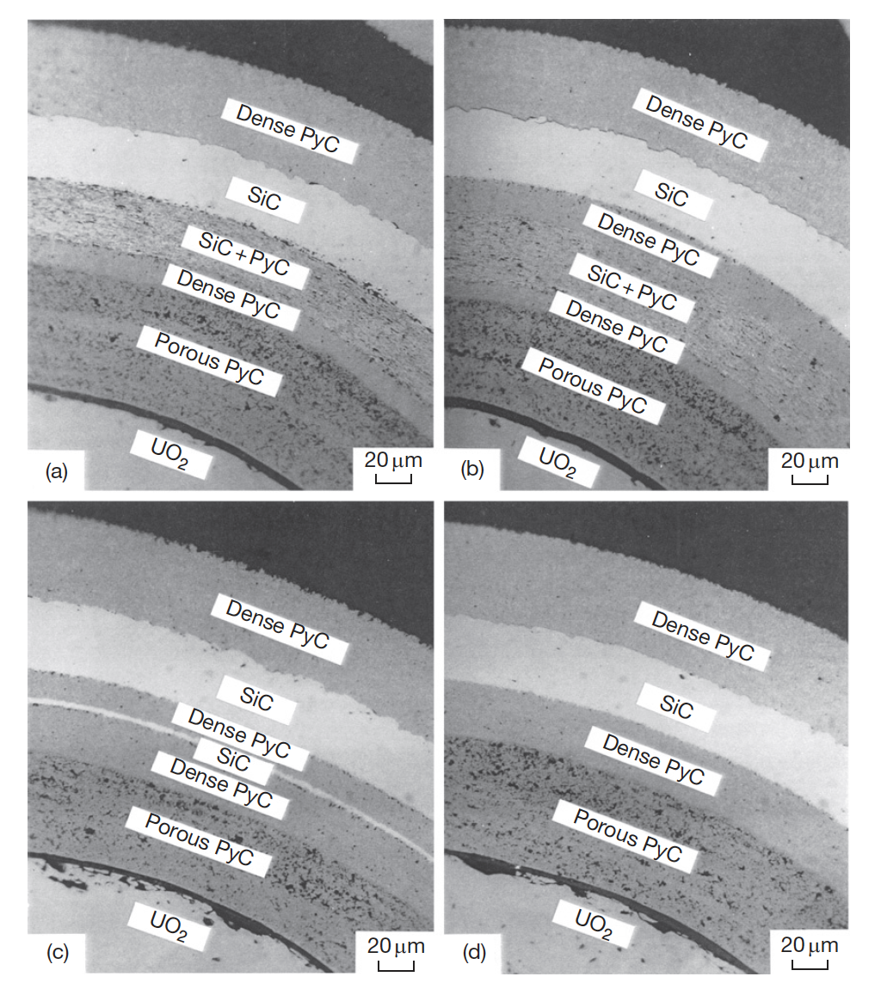
Alternate Layering
Two methods are available to prevent the corrosion of the SiC layer: (1) to keep the fission products within the fuel kernel and (2) to make a barrier to the diffusion of the fission products to the SiC layer
Can potentially add a layer that traps palladium by chemical reaction inside the SiC layer of the TRISO coating
Can add either an additional SiC layer, or a SiC/PyC composite layer

Slide 12
Alternate Layering
The type-A coating has an additional layer of SiC+PyC adjacent to the inside of the SiC layer; the thickness of the IPyC layer can be reduced
The type-B coating has the dense PyC layer between the SiC+PyC and SiC layers; the intermediate dense PyC layer will interrupt extension of the corrosion zone from the SiC+PyC layer to the SiC layer
In the type-C coating, SiC is used for an additional layer; SiC layer will react with fission products and PyC will interrupt corrosion of outer SiC

Slide 13
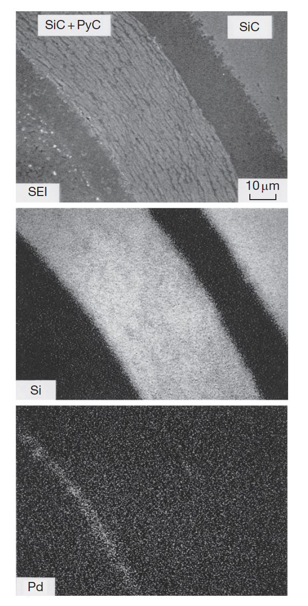
Alternate Layering
Irradiation of these advanced coatings was performed in the JRR-2 reactor
Ceramography revealed no crack in the advanced coating layers or in the TRISO coating layers
All three types trapped Pd at the inner SiC-based barrier, preventing corrosion of the outer SiC
At high heating, a PyC layer between the outer SiC and the inner SiC-based layer proved more effective at fission product retention
Also, the SiC/PyC layer proved more effective than pure SiC
No new technology needed to fabricate these particles
Type B Coating

Slide 14
Summary
Advanced concepts in TRISO particles
ZrC instead of SiC
ZrC/SiC around kernel
alternate layering of SiC/PyC
All aim to improve behavior in some fashion:
improved stability at high T
improved FP retention and mitigation of kernel migration
improved FP retention and mitigation of FP attack

Slide 15
Exam Upcoming
Will cover TRISO particle-based HTGRs
Exam will be on Sept 8
Open ended questions covering the concepts presented in class
Closed book

